Slide 1
Built-in Data Structures in Python
Lists, Dictionaries, Sets and Tuples
Dept. of CS&E, MSRIT

Slide 2
Motivation
We use lists in our everyday lives—we make shopping lists, to-do lists, and mental checklists.
Our DNA is essentially a long list of molecules in the form of a double helix, found in the nucleus of all human cells and all living organisms.
Its purpose is also to store information—specifically, the instructions that are used to construct all other cells in the body—that we call genes .
Given the 2.85 billion nucleotides that make up the human genome, determining their sequencing (and thus understanding our genetic makeup) is fundamentally a computational problem.
Dept. of CS&E, MSRIT

Slide 3
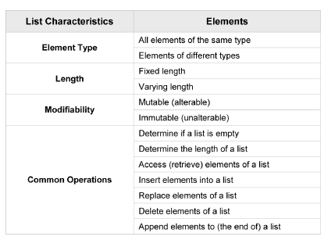
List characteristics
Dept. of CS&E, MSRIT

Slide 4
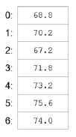
Lists
A list is a linear data structure , meaning that its elements have a linear ordering.
That is, there is a first element, a second element, and so on.
The values that make up a list are called its elements, or its items
Dept. of CS&E, MSRIT

Slide 5
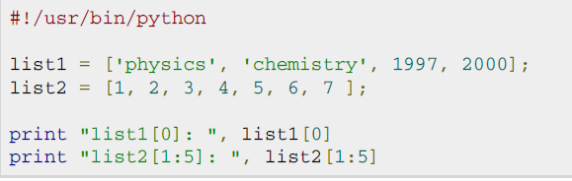

Accessing values in a Lists
Dept. of CS&E, MSRIT

Slide 6
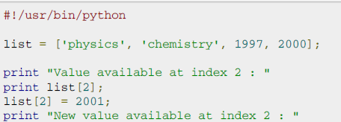
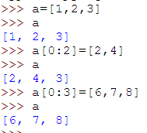

Updating values in a Lists
Dept. of CS&E, MSRIT

Slide 7
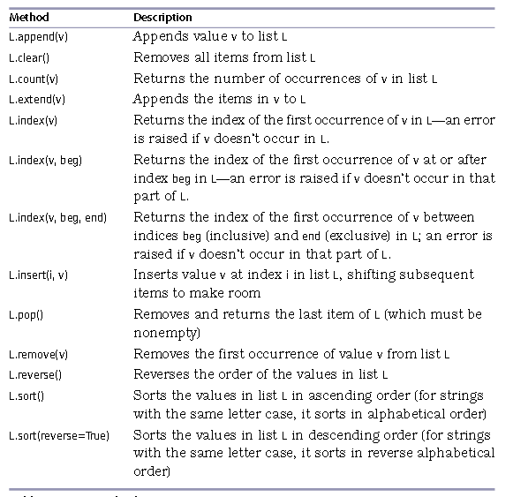
List Methods
Dept. of CS&E, MSRIT

Slide 8


To create a List
The simplest is to enclose the elements in square brackets [ and ]:
The elements of a list don’t have to be the same type.
Dept. of CS&E, MSRIT

Slide 9
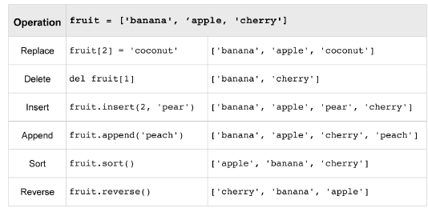
List Methods Example
Dept. of CS&E, MSRIT

Slide 10
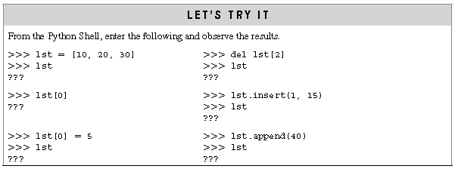
Answer this?
Dept. of CS&E, MSRIT

Slide 11



Append vs Extend
nums.append([6,7,8])
nums.extend([6,7,8])
Dept. of CS&E, MSRIT

Slide 12
Append vs Extend
“extend” takes a single argument, which is always a list, and adds each of the elements of that list to the original list.
”append” takes one argument, which can be any data type, and simply adds it to the end of the list.
Dept. of CS&E, MSRIT

Slide 13
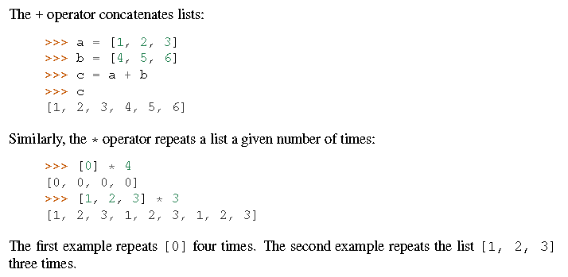
List Concatenation
Dept. of CS&E, MSRIT

Slide 14
List Slices
a[start:end]
# items start through end-1
a[start:]
# items start through the rest of the array
a[:end]
# items from the beginning through end-1
a[:]
# a copy of the whole array
a[start:end:step]
# start through not past end, by step
Dept. of CS&E, MSRIT

Slide 15
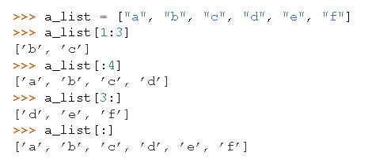
List Slices Example
Dept. of CS&E, MSRIT

Slide 16
List Slices Example
Negative List Indices accesses elements from the end of the list counting backwards. The last element of any non-empty list is always li[-1]
>>> li= ['a', 'b', 'mpilgrim', 'z', 'example']
>>> li[-1] returns 'example'
>>> li[-3] returns 'mpilgrim‘
Slicing Shorthand
>>> li[:3] returns ['a', 'b', 'mpilgrim']
>>> li[3:] returns ['z', 'example']
>>> li[:] returns ['a', 'b', 'mpilgrim', 'z', 'example']
Dept. of CS&E, MSRIT

Slide 17
Deleting List Elements
>>> a = [-1, 1, 66.25, 333, 333, 1234.5]
>>> del a[0]
>>> a
[1, 66.25, 333, 333, 1234.5]
>>> del a[2:4]
>>> a
[1, 66.25, 1234.5]
>>> del a[:]
>>> a
[]
Dept. of CS&E, MSRIT

Slide 18
Removing List Elements
“remove” removes the first occurrence of a value from a list.
If the value is not found in the list it raises an exception.
Pop does two things: it removes the last element of the list, and it returns the value that it removed. Note that this is different from li[-1], which returns a value but does not change the list, and different from li.remove(value), which changes the list but does not return a value.
Dept. of CS&E, MSRIT

Slide 19
Removing List Elements
>>> li = ['a', 'b', 'new', 'mpilgrim', 'z', 'example', 'new', 'two', 'elements']
>>> li.remove("z")
>>> li = ['a', 'b', 'new', 'mpilgrim', 'example', 'new', 'two', 'elements']
>>> li.remove("new")
>>> li = ['a', 'b', 'mpilgrim', 'example', 'new', 'two', 'elements']
>>> li.remove("c")
Traceback (innermost last): File "<interactive input>", line 1, in ? ValueError: list.remove(x): x not in list
>>> li.pop()
'elements'
>>> li ['a', 'b', 'mpilgrim', 'example', 'new', 'two']
Dept. of CS&E, MSRIT

Slide 20
Searching List Elements
index finds the first occurrence of a value in the list and returns the index.
>>> li = ['a', 'b', 'new', 'mpilgrim', 'z', 'example', 'new', 'two', 'elements']
>>> li.index("example")
5
>>> li.index("new")
2
>>> li.index("c")
Traceback (innermost last): File "<interactive input>", line 1, in ? ValueError: list.index(x): x not in list
>>> "c" in li
False
Dept. of CS&E, MSRIT

Slide 21
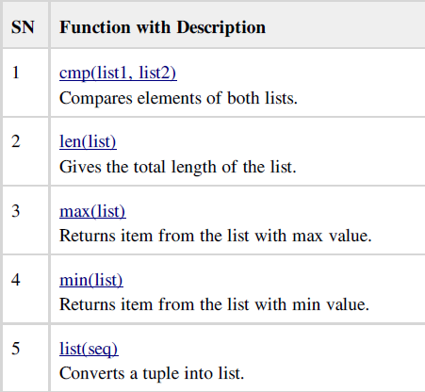
Built in List Functions
Dept. of CS&E, MSRIT

Slide 22
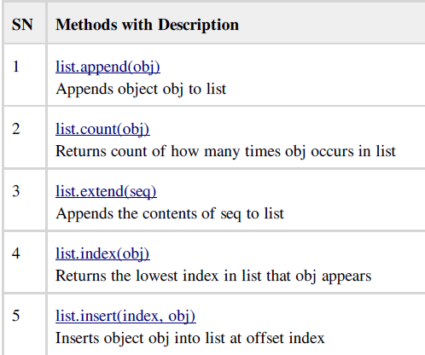
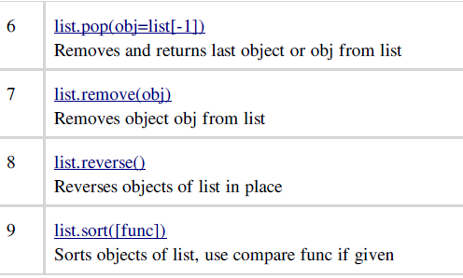
Built in List Functions
Dept. of CS&E, MSRIT

Slide 23
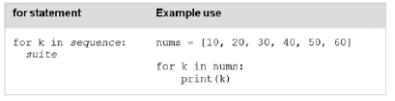

Iterating over Lists in Python
For Loops
While loop
Dept. of CS&E, MSRIT

Slide 24
Iterating over Lists in Python
# You can either use loops:
squares = []
for x in range(10):
squares.append(x**2)
print squares
[0, 1, 4, 9, 16, 25, 36, 49, 64, 81]
# Or you can use list comprehensions to get the same result:
squares = [x**2 for x in range(10)]
print squares
[0, 1, 4, 9, 16, 25, 36, 49, 64, 81]
Dept. of CS&E, MSRIT

Slide 25
Iterating over Lists in Python
listOfWords = ["this","is","a","list","of","words"]
items = [ word[0] for word in listOfWords]
print (items)
Output: ['t', 'i', 'a', 'l', 'o', 'w']
string = "Hello 12345 World"
numbers = [x for x in string if x.isdigit()]
print (numbers)
Output: ['1', '2', '3', '4', '5‘]
Dept. of CS&E, MSRIT

Slide 26
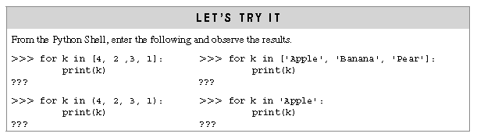
Answer this?
Dept. of CS&E, MSRIT

Slide 27
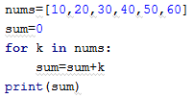
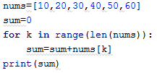
Iterating Over List Elements vs. List Index Values
Iterating Over List Elements
List Index Values
Dept. of CS&E, MSRIT

Slide 28
Tuples
A tuple is an immutable linear data structure. Thus, in contrast to lists, once a tuple is defined, it cannot be altered.
The syntax for declaring tuples in Python is given below.
tuples are denoted by parentheses instead of square brackets
Dept. of CS&E, MSRIT

Slide 29
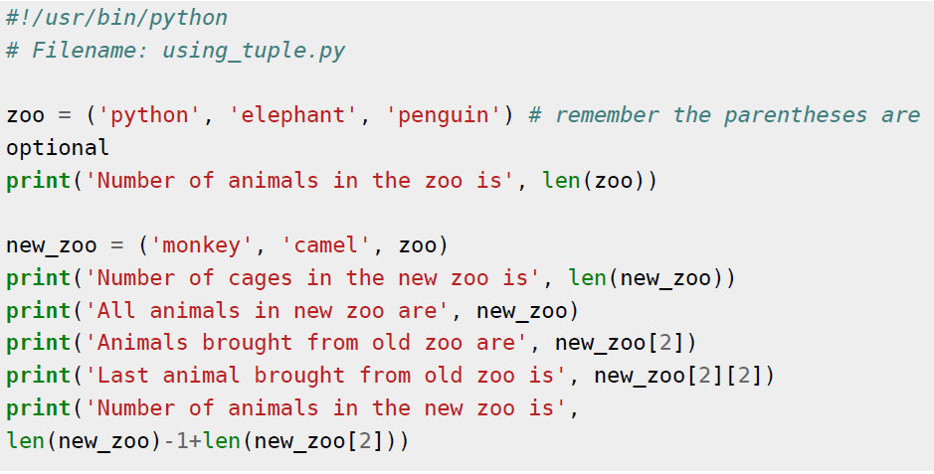
Tuples Example
Dept. of CS&E, MSRIT

Slide 30
Tuples
The empty tuple is written as two parentheses containing nothing:
tup1 = ()
To write a tuple containing a single value you have to include a comma, even though there is only one value:
tup1 = (50,)
Like string indices, tuple indices start at 0, and tuples can be sliced, concatenated and so on.
Dept. of CS&E, MSRIT

Slide 31
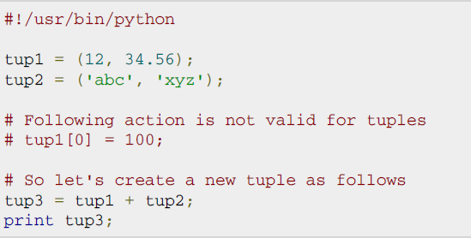
Updating Tuples
Tuples are immutable which means you cannot update them or change values of tuple elements. But we able to take portions of an existing tuples to create a new tuples as follows. Following is a simple example:
Dept. of CS&E, MSRIT

Slide 32
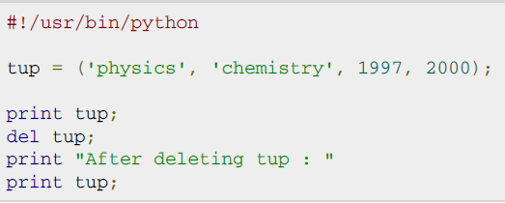
Deleting Tuple elements
Removing individual tuple elements is not possible. There is, of course, nothing wrong with putting together another tuple with the undesired elements discarded.
To explicitly remove an entire tuple, just use the del statement. This produce the error as after “del tup” tuple does not exist any more
Dept. of CS&E, MSRIT

Slide 33
Set
A set is a mutable data type with nonduplicate, unordered values, providing the usual mathematical set operations.
The syntax for declaring sets in Python is given below.
A={1,2,3,4}
Dept. of CS&E, MSRIT

Slide 34
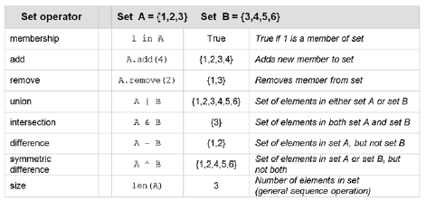
Set Methods
Dept. of CS&E, MSRIT

Slide 35
Self Test Questions
For set ‘s ‘ containing values 1, 2, 3, and set ‘t’ containing 3, 4, 5, which of the following are the correct results for each given set operation?
(a) s | t ➝
(b) s & t ➝
(c) s - t ➝
Dept. of CS&E, MSRIT

Slide 36
Self Test Questions
1. Which of the following sequence types is a mutable type?
(a) strings (b) lists (c) tuples
2. Which of the following is true?
(a) Lists and tuples are denoted by the use of square brackets.
(b) Lists are denoted by use of square brackets and tuples are denoted by the use of parentheses.
(c) Lists are denoted by use of parentheses and tuples are denoted by the use of square brackets.
3. Lists and tuples must each contain at least one element. (TRUE/FALSE)
4. For lst = [4, 2, 9, 1], what is the result of the following operation, lst.insert(2, 3)?
(a) [4, 2, 3, 9, 1] (b) [4, 3 ,2, 9, 1] (c) [4, 2, 9, 2, 1]
Dept. of CS&E, MSRIT

Slide 37
Dictionary
A dictionary is a mutable, associative data structure of variable length.
The syntax for declaring dictionaries in Python is given below.
daily_temps = {'sun': 68.8, 'mon': 70.2, 'tue': 67.2, 'wed': 71.8}
Key
Value
Dept. of CS&E, MSRIT

Slide 38
Dictionary
A dictionary is mutable and is another container type that can store any number of Python objects, including other container types.
Dictionaries consist of pairs (called items) of keys and their corresponding values.
Python dictionaries are also known as associative arrays or hash tables.
Keys are unique within a dictionary while values may not be.
The values of a dictionary can be of any type, but the keys must be of an immutable data type such as strings, numbers, or tuples.
Dept. of CS&E, MSRIT

Slide 39
Dictionary
The syntax for declaring dictionaries in Python is given below.
The syntax for accessing an element of a dictionary is the same as for accessing elements of sequence types, except that a key value is used within the square brackets instead of an index value:
daily_temps = {'sun': 68.8, 'mon': 70.2, 'tue': 67.2, 'wed': 71.8}
Key
Value
daily_temps['sun']
Key
Dept. of CS&E, MSRIT

Slide 40
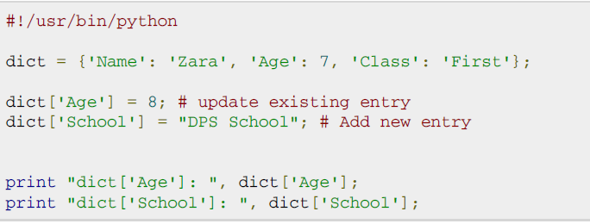

Updating Dictionary
Dept. of CS&E, MSRIT

Slide 41
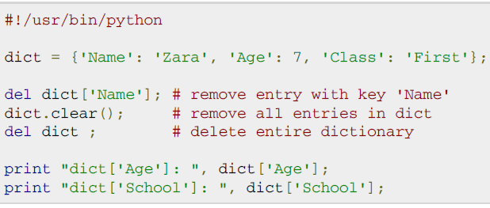
Deleting Dictionary elements
Dept. of CS&E, MSRIT

Slide 42



Properties of dictionary Keys
More than one entry per key not allowed. Which means no duplicate key is allowed. When duplicate keys encountered during assignment, the last assignment wins.
Keys must be immutable. Which means you can use strings, numbers, or tuples as dictionary keys but something like ['key'] is not allowed..
Dictionary Keys Are Case-Sensitive
Dept. of CS&E, MSRIT

Slide 43
Dictionary Methods
dict.items()
Returns a list of dict's (key, value) tuple pairs.
dict.keys()
Returns list of dictionary dict's keys
dict.values()
Returns list of dictionary dict's values
dict.update(dict2)
Adds dictionary dict2's key-values pairs to dict
Dept. of CS&E, MSRIT

Slide 44
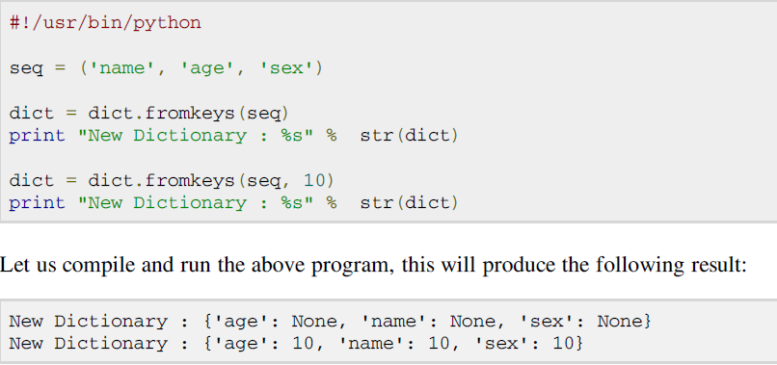
Dictionary fromKeys( ) method
The method fromkeys() creates a new dictionary with keys from seq and values set to value.
dict.fromkeys(seq[, value]))
seq -- This is the list of values which would be used for dictionary keys preparation.
value -- This is optional, if provided then value would be set to this value
Dept. of CS&E, MSRIT

Slide 45
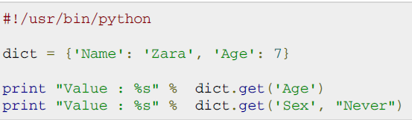

Dictionary get( ) method
The method get() return a value for the given key. If key is not available then returns default value None.
dict.get(key, default=None)
Dept. of CS&E, MSRIT

Slide 46
in Operator in dictionary
‘in’ operator to test whether the dictionary had a certain key
Example
dict={1:’a’,2:’b’,3:’c’}
>>> 1 in dict
>>> true
Dept. of CS&E, MSRIT

Slide 47
Examples and Exercises
Access the 03_Day Directive
Dept. of CS&E, MSRIT

